Slide 1
C++ is Fun – Part Six at Turbine/Warner Bros.!
Russell Hanson

Slide 2
Syllabus
1) First program and introduction to data types and control structures with applications for games learning how to use the programming environment Mar 25-27
2) Objects, encapsulation, abstract data types, data protection and scope April 1-3
3) Basic data structures and how to use them, opening files and performing operations on files -- We’re here April 8-10
4) Algorithms on data structures, algorithms for specific tasks, simple AI and planning type algorithms, game AI algorithms April 15-17
Project 1 Due – April 17
5) More AI: search, heuristics, optimization, decision trees, supervised/unsupervised learning – April 22-24
6) Game API and/or event-oriented programming, model view controller, map reduce filter – April 29, May 1
7) Basic threads models and some simple databases SQLite May 6-8
8) Graphics programming, shaders, textures, 3D models and rotations May 13-15
Project 2 Due May 15
9) How to download an API and learn how to use functions in that API, Windows Foundation Classes May 20-22
10) Designing and implementing a simple game in C++ May 27-29
11) Selected topics – Gesture recognition & depth controllers like the Microsoft Kinect, Network Programming & TCP/IP, OSC June 3-5
12) Working on student projects - June 10-12
Final project presentations Project 3/Final Project Due June 12

Slide 3
Project 1 due in 1 week
Therefore, we’re going to spend time in class working on the project, last 30 minutes of class

Slide 4
Class Activity: Pointers and memory management!
#include "stdafx.h"
// This program uses the & operator to determine a variable’s
// address and the sizeof operator to determine its size.
#include <iostream>
using namespace std;
int main()
{
int x = 25;
cout << "The address of x is " << &x << endl;
cout << "The size of x is " << sizeof(x) << " bytes\n";
cout << "The value in x is " << x << endl;
system("PAUSE");
return 0;
}
The address of x is 0029FE74
The size of x is 4 bytes
The value in x is 25
Press any key to continue . . .

Slide 5
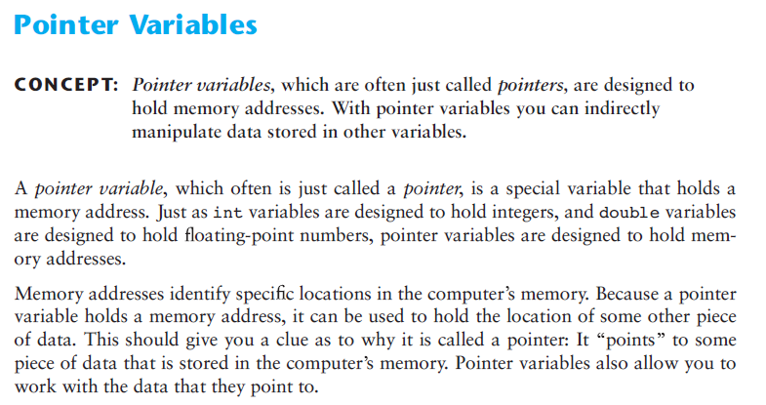

Slide 6
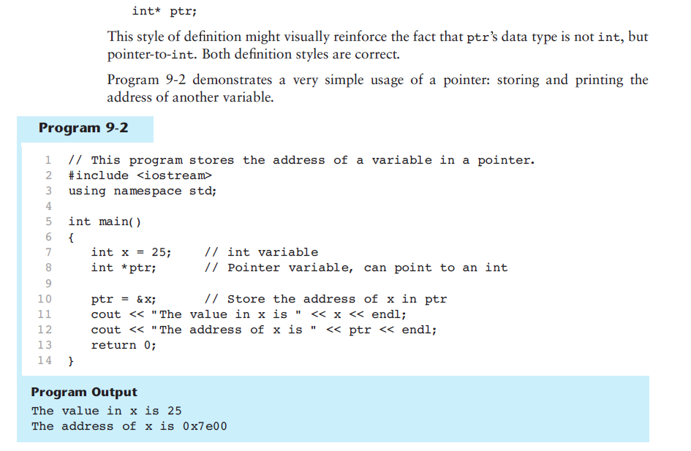

Slide 7
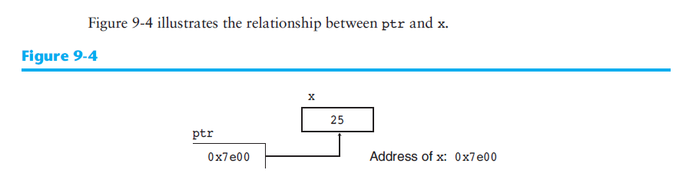

Slide 8
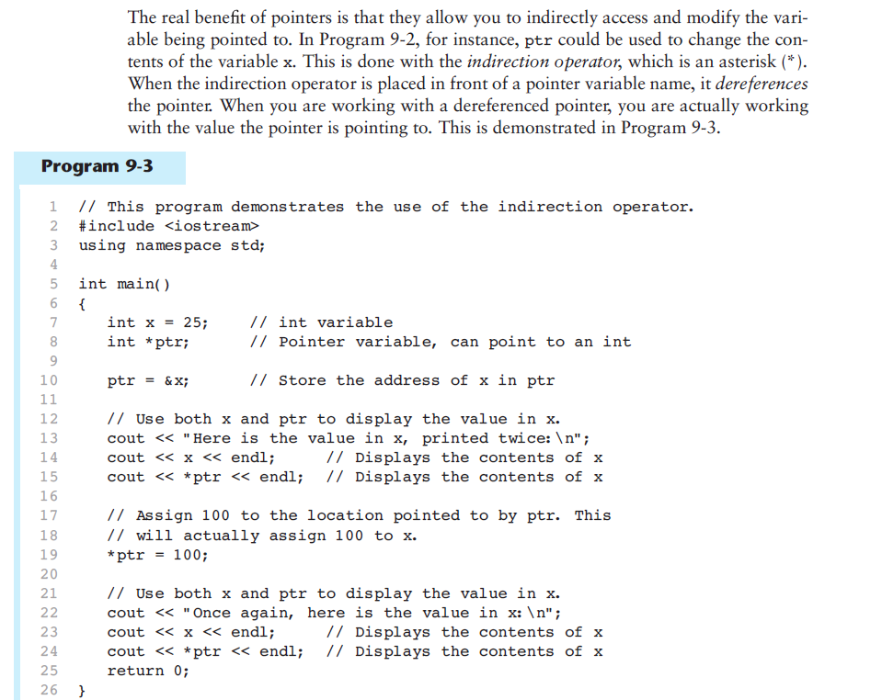

Slide 9
Class Activity: Use the indirection operator
#include "stdafx.h"
// This program demonstrates the use of the indirection operator.
#include <iostream>
using namespace std;
int main()
{
int x = 25; // int variable
int *ptr; // Pointer variable, can point to an int
ptr = &x; // Store the address of x in ptr
// Use both x and ptr to display the value in x.
cout << "Here is the value in x, printed twice:\n";
cout << x << endl; // Displays the contents of x
cout << *ptr << endl; // Displays the contents of x
// Assign 100 to the location pointed to by ptr. This
// will actually assign 100 to x.
*ptr = 100;
// Use both x and ptr to display the value in x.
cout << "Once again, here is the value in x:\n";
cout << x << endl; // Displays the contents of x
cout << *ptr << endl; // Displays the contents of x
system("PAUSE");
return 0;
}

Slide 10
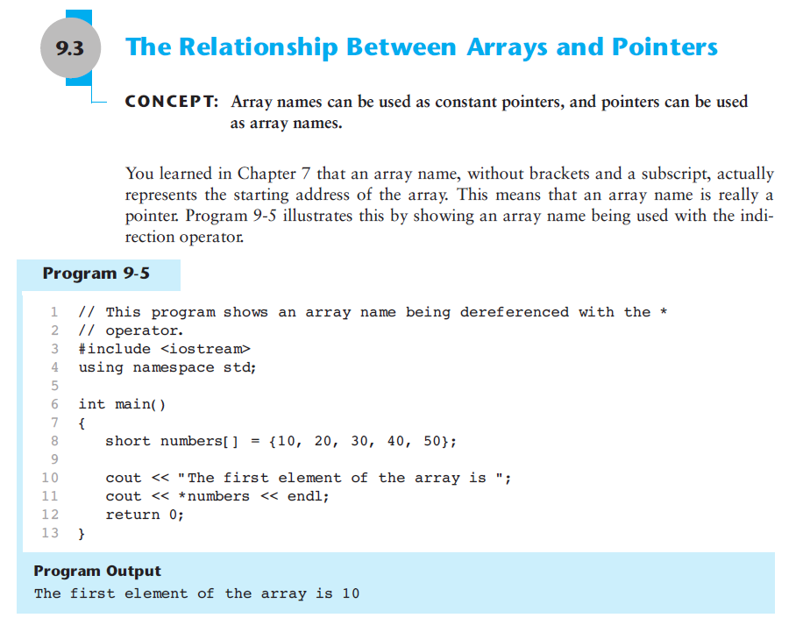

Slide 11
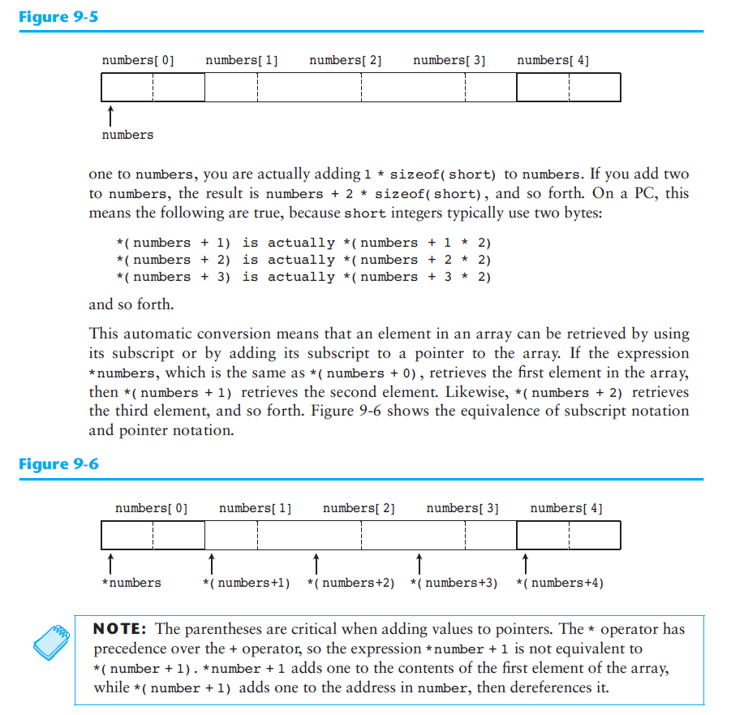

Slide 12

Class Activity: Access array using pointer notation
#include "stdafx.h"
// This program shows an array name being dereferenced with the *
// operator.
#include <iostream>
using namespace std;
int main()
{
int numbers[] = {10, 20, 30, 40, 50};
cout << "The first element of the array is ";
cout << *numbers << endl;
cout << "The second element of the array is ";
cout << *(numbers+1) << endl;
cout << "The third element of the array is ";
cout << *(numbers+2) << endl;
cout << "The second element of the array is not ";
cout << *numbers+1 << endl;
system("PAUSE");
return 0;
}

Slide 13
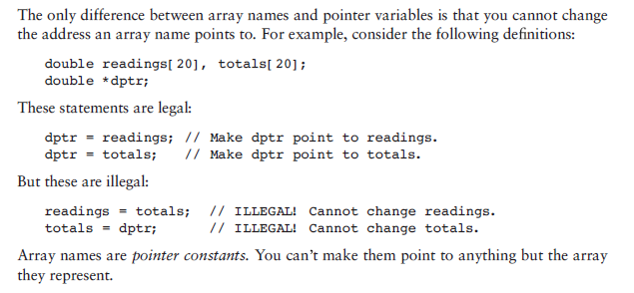
Array names are pointer constants

Slide 14
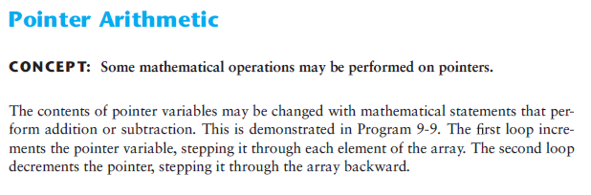
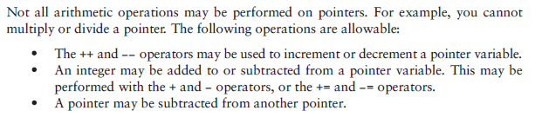
Pointer arithmetic

Slide 15
Class Activity: Pointer Arithmetic
#include "stdafx.h"
// This program uses a pointer to display the contents of an array.
#include <iostream>
using namespace std;
int main()
{
const int SIZE = 8;
int set[SIZE] = {5, 10, 15, 20, 25, 30, 35, 40};
int *numPtr; // Pointer
int count; // Counter variable for loops
// Make numPtr point to the set array.
numPtr = set;
// Use the pointer to display the array contents.
cout << "The numbers in set are:\n";
for (count = 0; count < SIZE; count++)
{
cout << *numPtr << " ";
numPtr++;
}
// Display the array contents in reverse order.
cout << "\nThe numbers in set backward are:\n";
for (count = 0; count < SIZE; count++)
{
numPtr--;
cout << *numPtr << " ";
}
system("Pause");
return 0;
}

Slide 16
Pointer to an array vs. array of pointers
int main(){
int (*iptr)[50];
// int* iptr[50];
// Error 1 error C2440: '=' : cannot convert from 'int (*)[50]' to 'int *[50]'
iptr = new int[100000000][50];
cout << iptr;
system("Pause");
return 0;
/* The trick is to parenthisize the pointer declaration.
This informs C++ that you want a pointer to an array, rather than array of pointers.
Writing
int (*a)[10];
declares that a is a pointer to an array of 10 ints. By constrast,
int *a[10];
declares that a is an array of 10 pointers to ints.
Instead of writing
object (*ptr)[10] = new object[5][10];
or
object (*ptr)[10][15] = new object[5][10][15];
you must write
typedef object (*ObjectArray)[5][10][15];
ObjectArray ptr = (ObjectArray) new object[5][10][15];
You would also have to dereference the array whenever you refer to an element. For example,
(*ptr)[4][3][2] = 0;
*/
}
Or use a vector then you do not need to free the memory, because the std::vector destructor will do it for you.

Slide 17
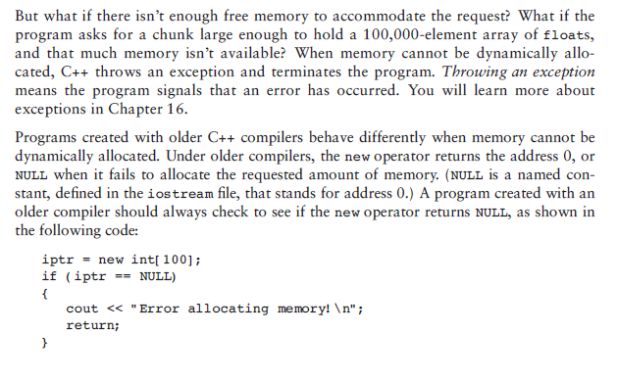
Checking return value of new

Slide 18
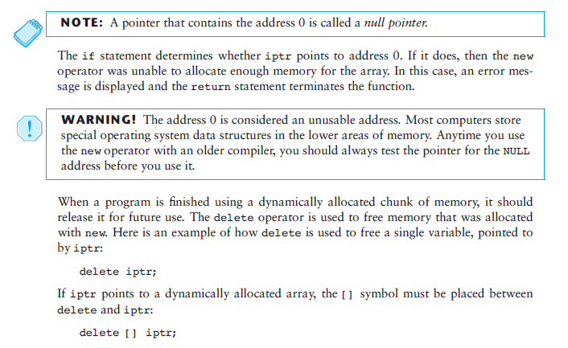
The null pointer

Slide 19
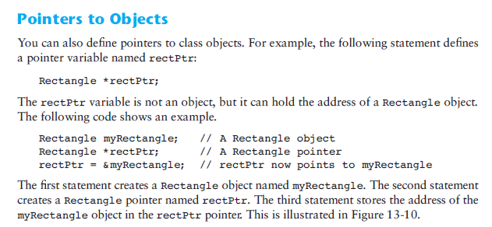
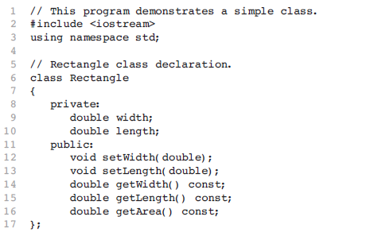
Pointers to Objects, too

Slide 20
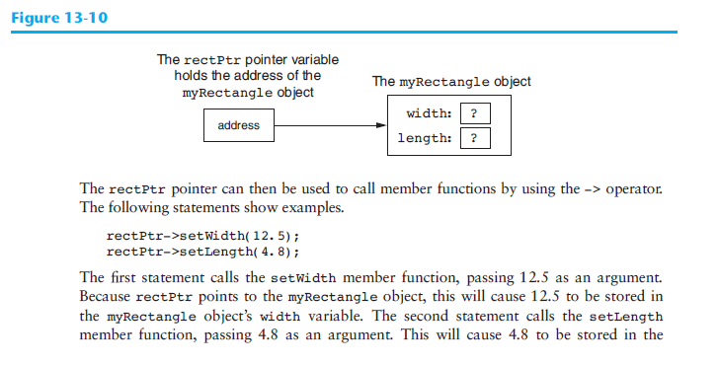

Slide 21
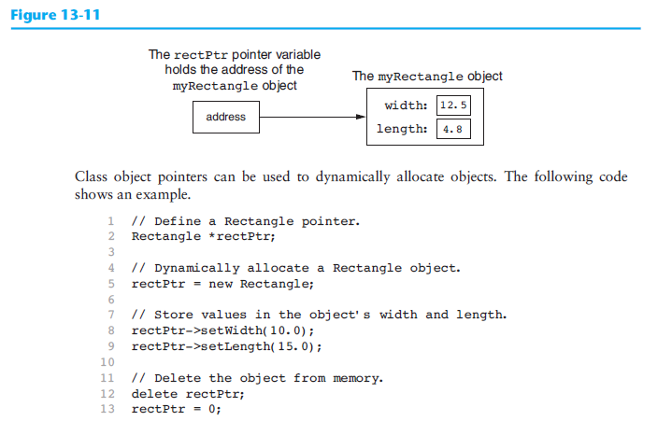

Slide 22
int main(){
double number; // To hold a number
double totalArea; // The total area
Rectangle *kitchen; // To point to kitchen dimensions
Rectangle *bedroom; // To point to bedroom dimensions
Rectangle *den; // To point to den dimensions
// Dynamically allocate the objects.
kitchen = new Rectangle;
bedroom = new Rectangle;
den = new Rectangle;
// Get the kitchen dimensions.
cout << "What is the kitchen's length? ";
cin >> number; // Get the length
kitchen->setLength(number); // Store in kitchen object
cout << "What is the kitchen's width? ";
cin >> number; // Get the width
kitchen->setWidth(number); // Store in kitchen object
// Get the bedroom dimensions.
cout << "What is the bedroom's length? ";
cin >> number; // Get the length
bedroom->setLength(number); // Store in bedroom object
cout << "What is the bedroom's width? ";
cin >> number; // Get the width
bedroom->setWidth(number); // Store in bedroom object
// Get the den dimensions.
cout << "What is the den's length? ";
cin >> number; // Get the length
den->setLength(number); // Store in den object
cout << "What is the den's width? ";
cin >> number; // Get the width
den->setWidth(number); // Store in den object
// Calculate the total area of the three rooms.
totalArea = kitchen->getArea() + bedroom->getArea() + den->getArea();
// Display the total area of the three rooms.
cout << "The total area of the three rooms is " << totalArea << endl;
// Delete the objects from memory.
delete kitchen;
delete bedroom;
delete den;
kitchen = 0; // Make kitchen point to null.
bedroom = 0; // Make bedroom point to null.
den = 0; // Make den point to null.
return 0;
}

Slide 23
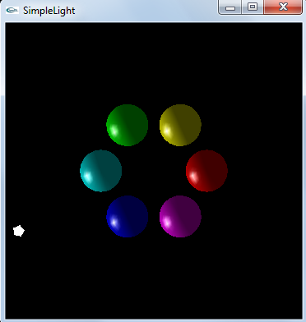
Class Activity: Install GLUT, and compile and run a simple OpenGL program
http://www.math.ucsd.edu/~sbuss/MathCG/OpenGLsoft/SimpleLight/SimpleLight.html
SimpleLight illustrates the use Phong lighting in OpenGL. It draws six spheres of different colors, and makes a white light revolve around the spheres. It consists of two source files, SimpleLight.c and SimpleLight.h. There are several options available for downloading this program:
SimpleLightProject.zip: A zip file, including the source files, Microsoft Visual C++ workspace and project files, and Win32 executable.
SimpleLight.zip: A zip file, with sources files and the executable.
SimpleLight.c and SimpleLight.h and SimpleLight.exe: Download the two source files and the executable, one at a time.

Slide 24
Installing GLUT
If GLUT is not installed, you can install it by downloading the
glut zip file (v. 3.7.6) (web site) and copying its files as follows:
runtime library:
C:\Program Files\Microsoft Visual Studio *\VC\bin\glut32.dll
["Program Files (x86)" for 64-bit Windows; The '*' matches your version of VS: 11.0 for VS2012, 10.0 for VS2010, 9.0 for VS2008]
header file:
C:\Program Files\Microsoft Visual Studio *\VC\include\GL\glut.h
["Program Files (x86)" for 64-bit Windows; You have to create the "GL" directory]
linker library:
C:\Program Files\Microsoft Visual Studio *\VC\lib\glut32.lib
["Program Files (x86)" for 64-bit Windows]

Slide 25
Managing keyboard input in GLUT
// glutKeyboardFunc is called below to set this function to handle
// all "normal" key presses.
void myKeyboardFunc( unsigned char key, int x, int y )
{
switch ( key ) {
case 'r':
RunMode = 1-RunMode; // Toggle to opposite value
if ( RunMode==1 ) {
glutPostRedisplay();
}
break;
case 's':
RunMode = 1;
drawScene();
RunMode = 0;
break;
case 'l': // Toggle local light mode
LightIsPositional = 1 - LightIsPositional;
if ( RunMode==0 ) {
drawScene();
}
break;
case 27: // Escape key
exit(1);
}
}

Slide 26
Overview of the main() function in GLUT
// Main routine
// Set up OpenGL, define the callbacks and start the main loop
int main( int argc, char** argv )
{
glutInit(&argc,argv);
// We're going to animate it, so double buffer
glutInitDisplayMode(GLUT_DOUBLE | GLUT_RGB | GLUT_DEPTH );
// Window position (from top corner), and size (width% and hieght)
glutInitWindowPosition( 10, 60 );
glutInitWindowSize( 360, 360 );
glutCreateWindow( "SimpleLight" );
// Initialize OpenGL parameters.
initRendering();
// Set up callback functions for key presses
glutKeyboardFunc( myKeyboardFunc ); // Handles "normal" ascii symbols
glutSpecialFunc( mySpecialKeyFunc ); // Handles "special" keyboard keys
// Set up the callback function for resizing windows
glutReshapeFunc( resizeWindow );
// Call this for background processing
// glutIdleFunc( myIdleFunction );
// Call this whenever window needs redrawing
glutDisplayFunc( drawScene );
fprintf(stdout, "Arrow keys control speed. Press \"r\" to run, \"s\" to single step.\n");
// Start the main loop. glutMainLoop never returns.
glutMainLoop( );
return(0); // This line is never reached.
}

Slide 27
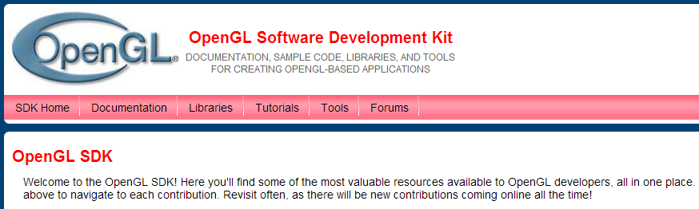
3D and 2D graphics and OpenGL provide some nice alternatives to the console…
http://sourceforge.net/projects/ogl-samples/files/latest/download
http://www.cmake.org/files/v2.8/cmake-2.8.10.2-win32-x86.exe
$ /cygdrive/c/Program\ Files/CMake\ 2.8/bin/cmake.exe CMakeLists.txt
-- Building for: Visual Studio 11
-- The C compiler identification is MSVC 17.0.50727.1
-- The CXX compiler identification is MSVC 17.0.50727.1
-- Check for working C compiler using: Visual Studio 11
-- Check for working C compiler using: Visual Studio 11 -- works
-- Detecting C compiler ABI info
-- Detecting C compiler ABI info - done
-- Check for working CXX compiler using: Visual Studio 11
-- Check for working CXX compiler using: Visual Studio 11 -- works
-- Detecting CXX compiler ABI info
-- Detecting CXX compiler ABI info - done
-- Found OpenGL: opengl32
-- Configuring done
-- Generating done
-- Build files have been written to: C:/russell/TurbineWarnerBros/ogl-samples-4.3.2.1/ogl-samples-4.3.2.1

Slide 28

GPU Programming
https://developer.nvidia.com/nvidia-visual-profiler

Slide 29

Widget toolkits enable GUIs and user interfaces beyond the console
http://www.vtk.org/

Slide 30
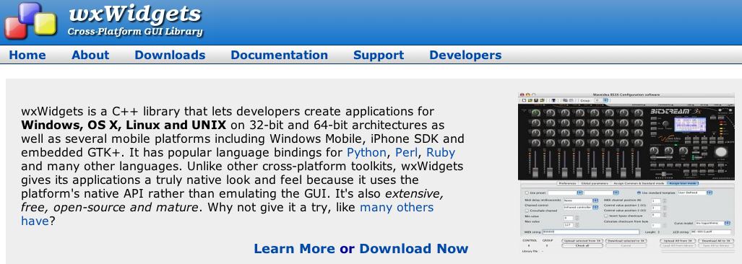
wxWidgets
http://www.wxwidgets.org/

Slide 31
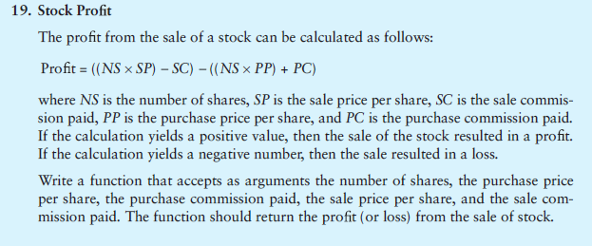
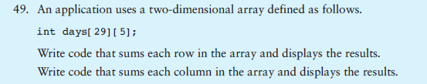
Homework #3 Exercises for next Monday (pick 2)
1)
2)

Slide 32

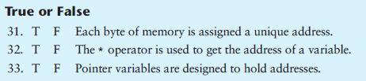
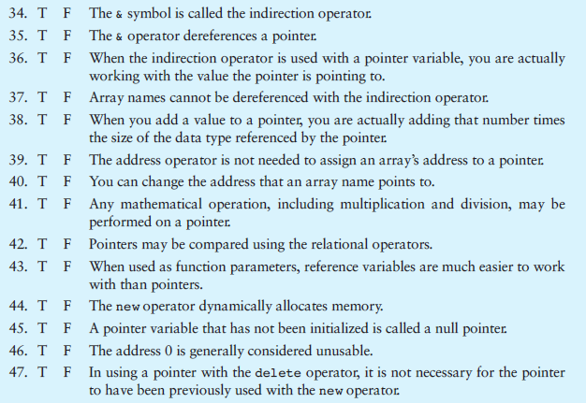
3)
4)

Slide 33
5) Implement three different pointer casts such as dynamic_cast, __try_cast, static_cast, reinterpret_cast, const_cast, C-Style Casts
as described in http://msdn.microsoft.com/en-us/library/aa712854(v=vs.71).aspx

